Slide 1
Deep Learning
Feedforward Networks and Backpropagation

Slide 2
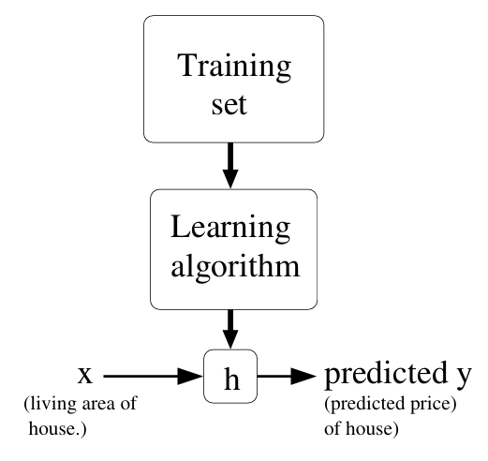
Supervised Learning (Recap)
Hypothesis
Features
Target

Slide 3
Recap
If the relation between x and y are linear
Linear Regression
If the samples of the classes are linearly separable,
Logistic Regression

Slide 4

What if the relation between $x$ and $y$ are non-linear?
What if the classes in the classification task are not linearly separable?

Slide 5
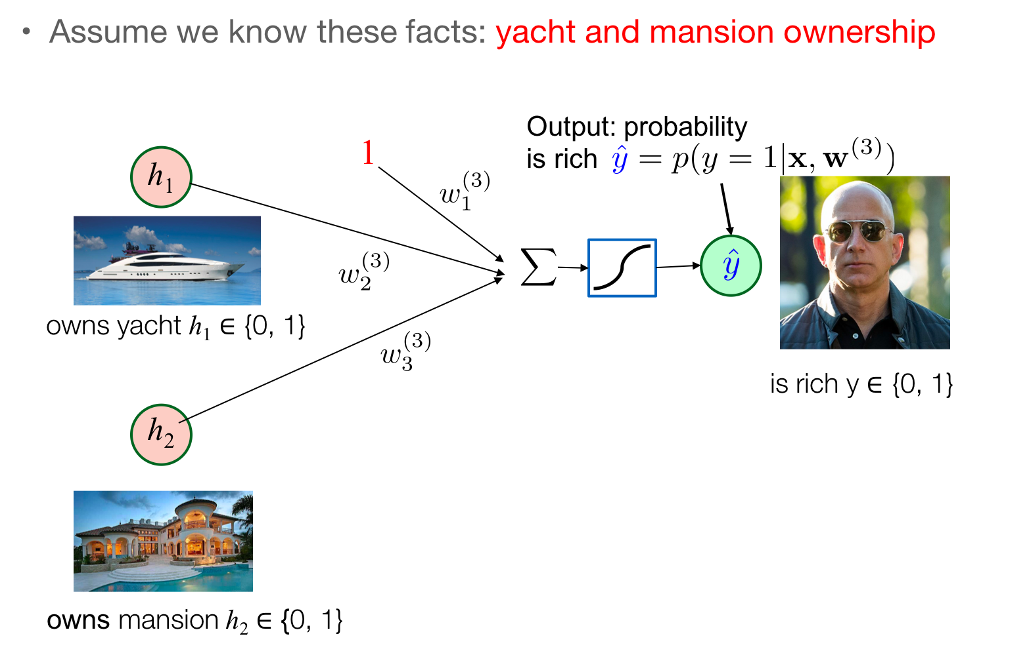
Predict Rich Or Not

Slide 6
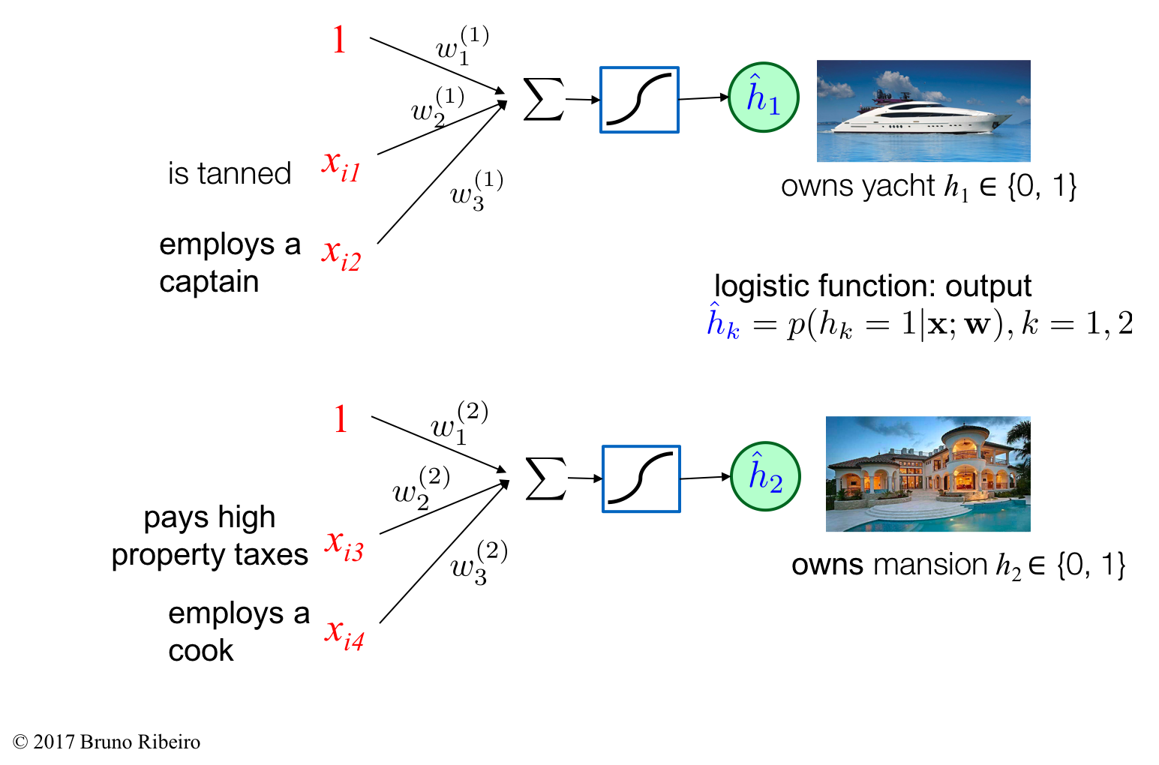
Predict Rich Or Not

Slide 7
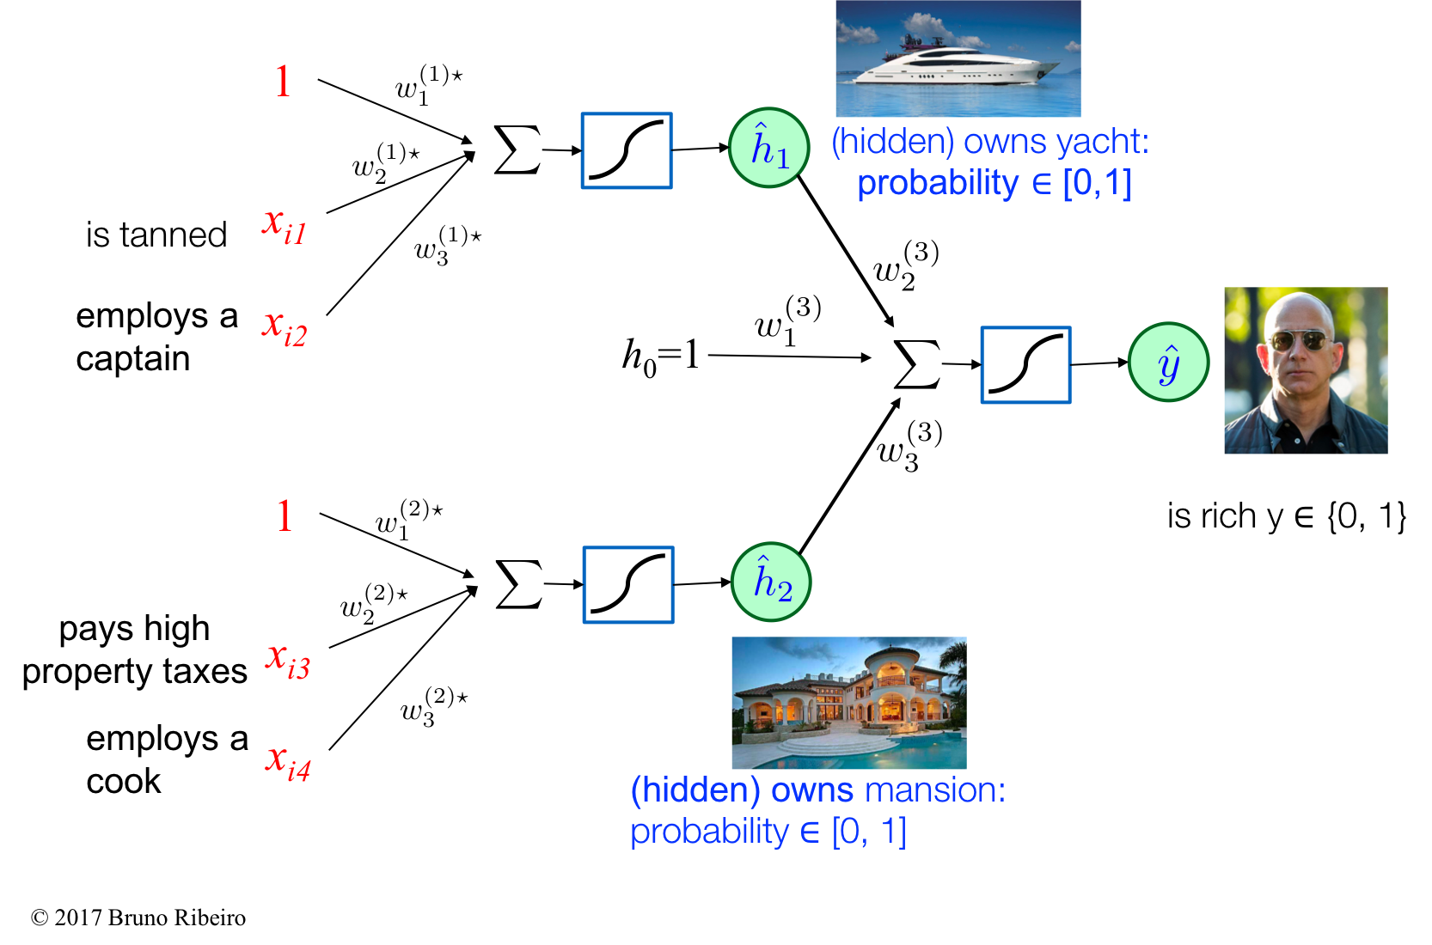
Predict Rich Or Not

Slide 8
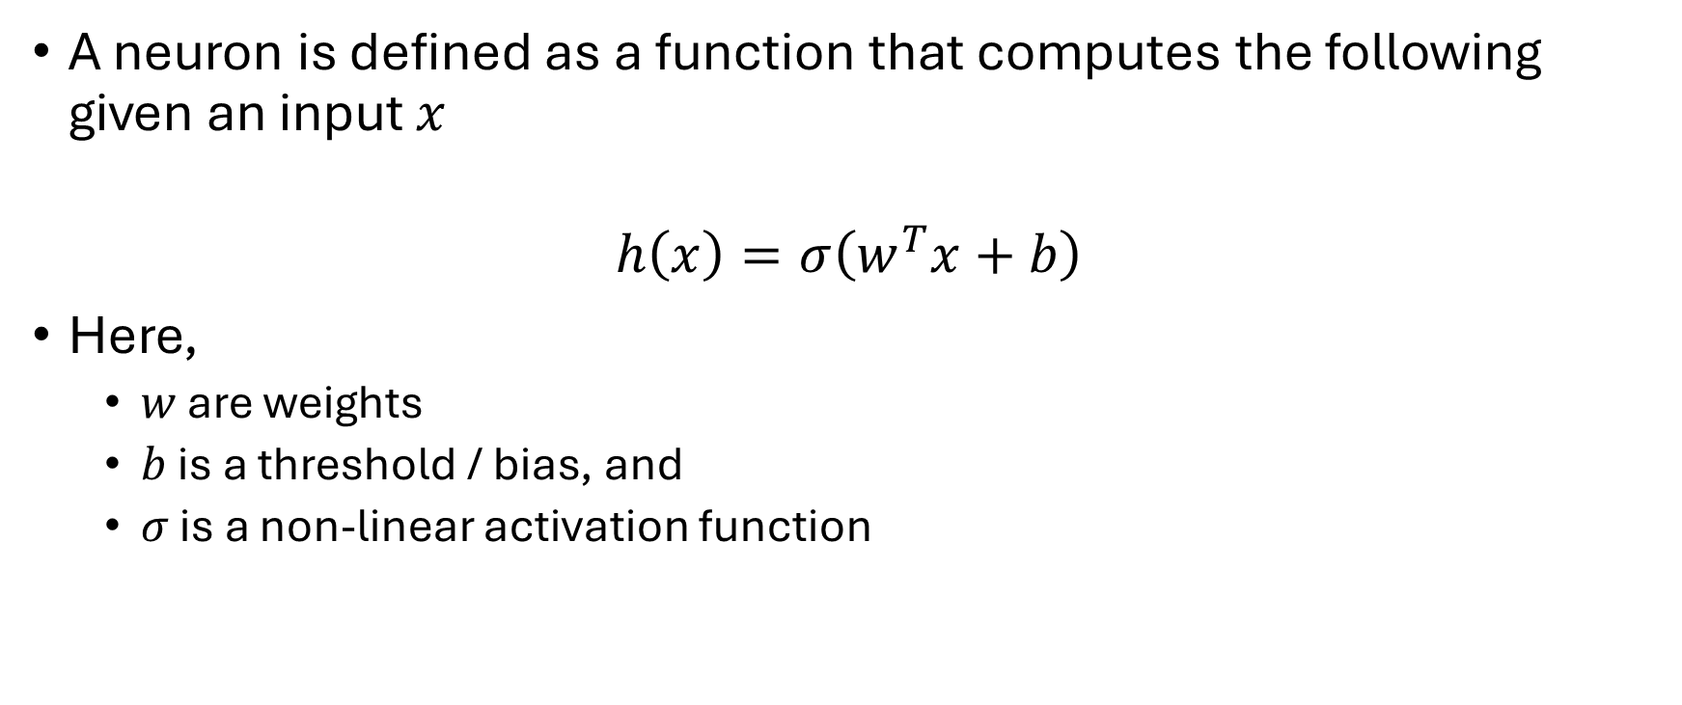
Neural Network
A neuron is defined as a function that computes the following given an input $x$
$$h\left(x\right)=σ\left(w^{T}x+b\right)$$
Here,
$w$ are weights
$b$ is a threshold / bias, and
$σ$ is a non-linear activation function

Slide 9
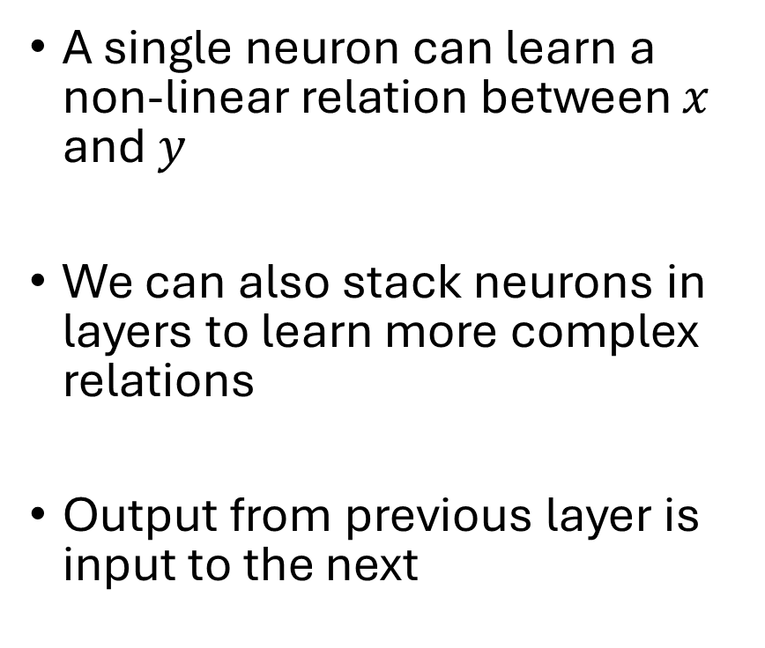
Neural Network
A single neuron can learn a non-linear relation between $x$ and $y$
We can also stack neurons in layers to learn more complex relations
Output from previous layer is input to the next
For example, the rich prediction can be modeled as,
Is Tanned?
Employs a
Captain?
Is Rich?
Pays Property
Tax?
Employs a
cook?

Slide 10
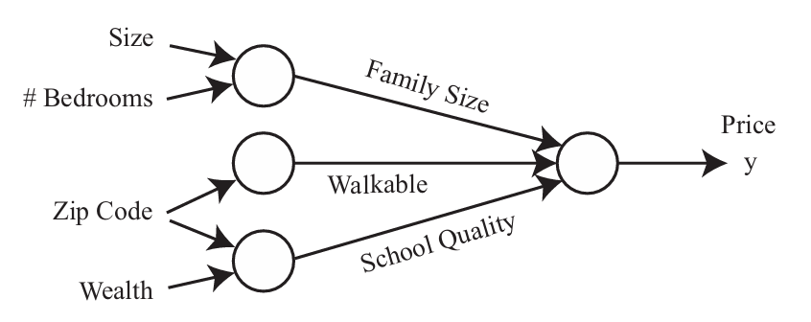
Neural Network
Another example, if more features are available the housing price prediction can be modeled as,

Slide 11
Fully-connected Neural Network
Prior knowledge about the features may not be available
Output from a neuron is input to every neuron in the next layer
Also called Multilayer Perceptron

Slide 12
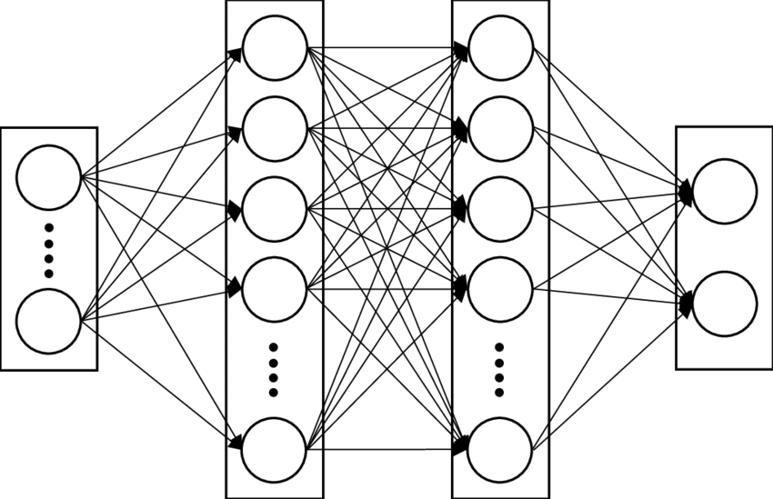
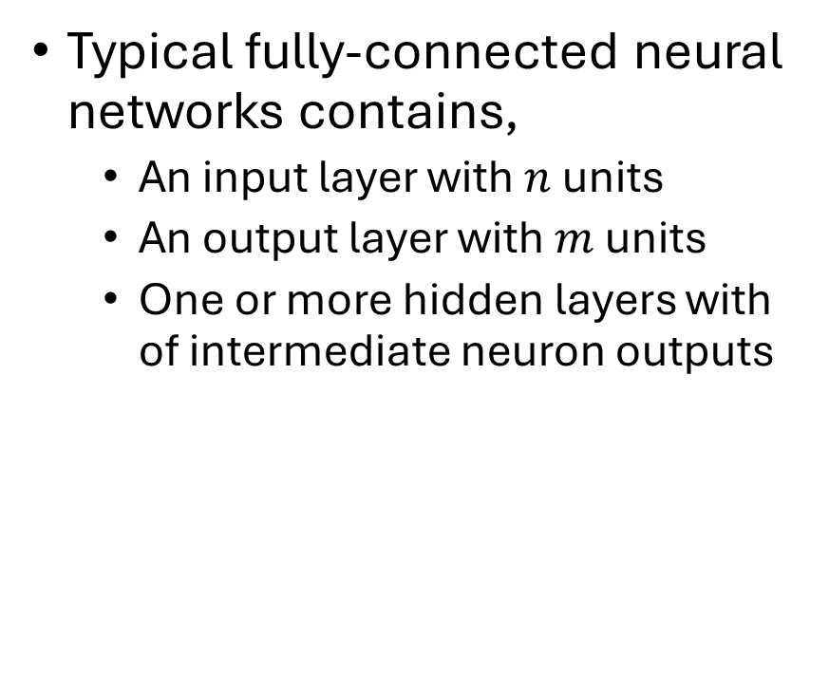
Fully-connected Neural Network
Typical fully-connected neural networks contains,
An input layer with $n$ units
An output layer with $m$ units
One or more hidden layers with of intermediate neuron outputs
Input
Layer
Output
Layer
Hidden Layers

Slide 13
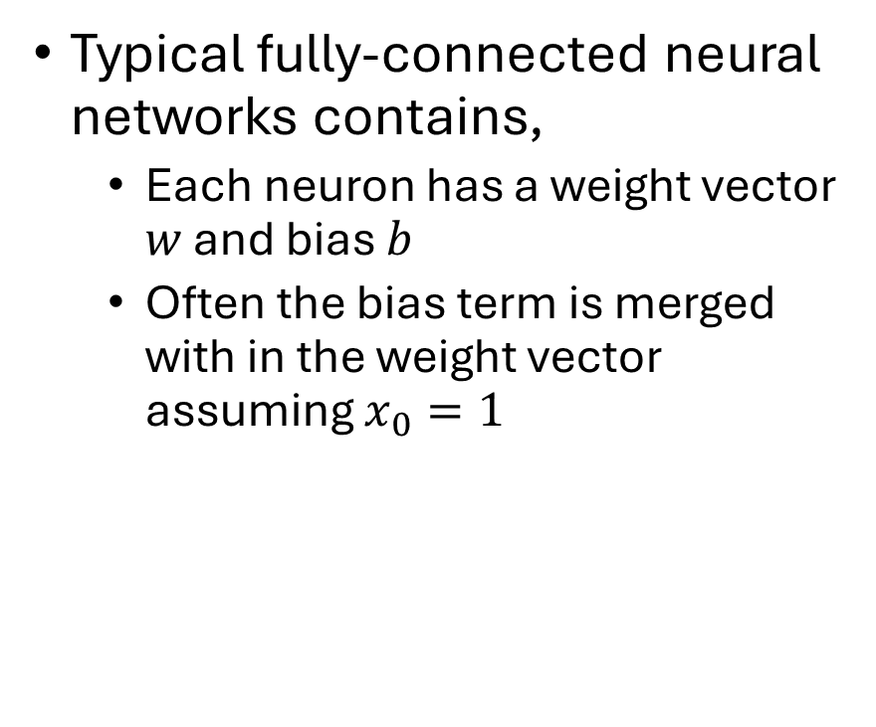
Fully-connected Neural Network
Typical fully-connected neural networks contains,
Each neuron has a weight vector $w$ and bias $b$
Often the bias term is merged with in the weight vector assuming $x_{0}=1$
Input
Layer
Output
Layer
Hidden Layers

Slide 14
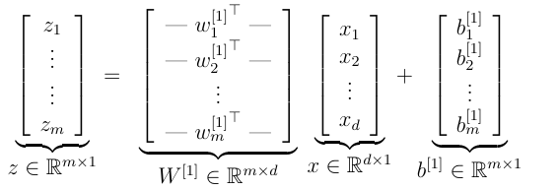















Fully-connected Neural Network
Vectorization
$$z_{1}^{}$$
$$z_{2}^{}$$
$$w_{1}^{1}$$
$$w_{1}^{1}$$
$$w_{2}^{1}$$
$$w_{2}^{1}$$
$$x_{1}$$
$$w_{3}^{1}$$
$$w_{3}^{1}$$
$$w_{4}^{1}$$
$$w_{4}^{1}$$
$$x_{2}$$
Input
Layer
$$w_{m}^{1}$$
$$w_{n_{1}}^{1}$$
Output
Layer
Hidden Layers

Slide 15
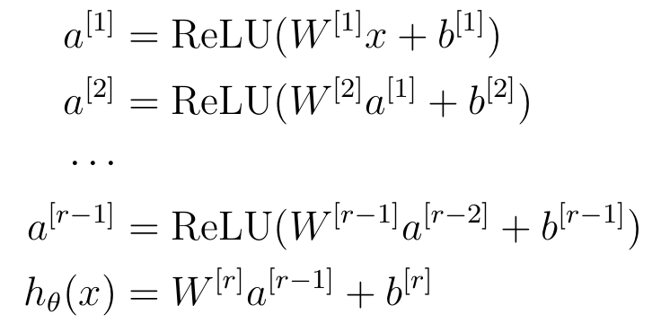
Fully-connected Neural Network
Multilayer Fully-connected Networks
$$z_{1}^{}$$
$$z_{2}^{}$$
$$w_{1}^{1}$$
$$w_{1}^{1}$$
$$w_{2}^{1}$$
$$w_{2}^{1}$$
$$x_{1}$$
$$w_{3}^{1}$$
$$w_{3}^{1}$$
$$w_{4}^{1}$$
$$w_{4}^{1}$$
$$x_{2}$$
Input
Layer
$$w_{m}^{1}$$
$$w_{n_{1}}^{1}$$
Output
Layer
Hidden Layers

Slide 16


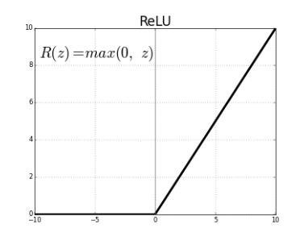
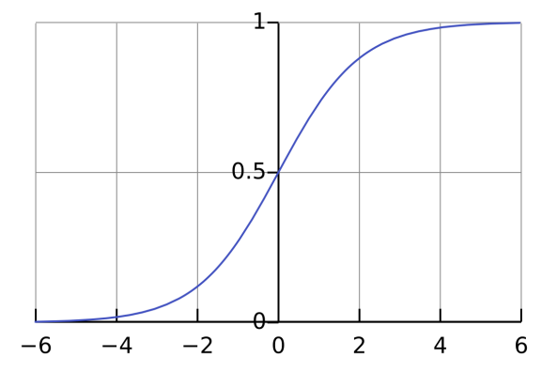
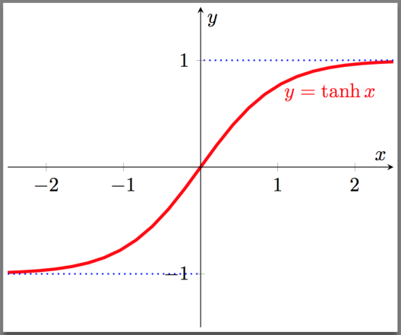
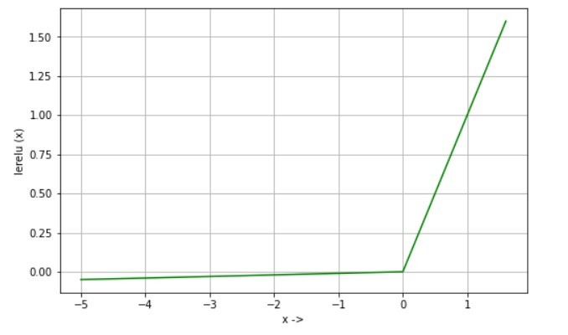
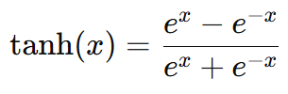
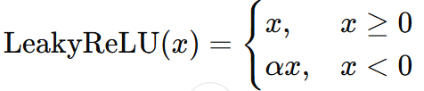
Activation Functions
Introduces Non-linearity in the Network
Sigmoid
ReLU
Leaky ReLU
Tanh

Slide 17
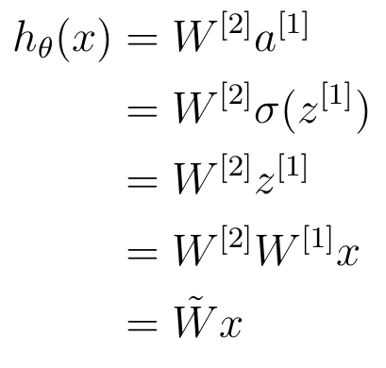
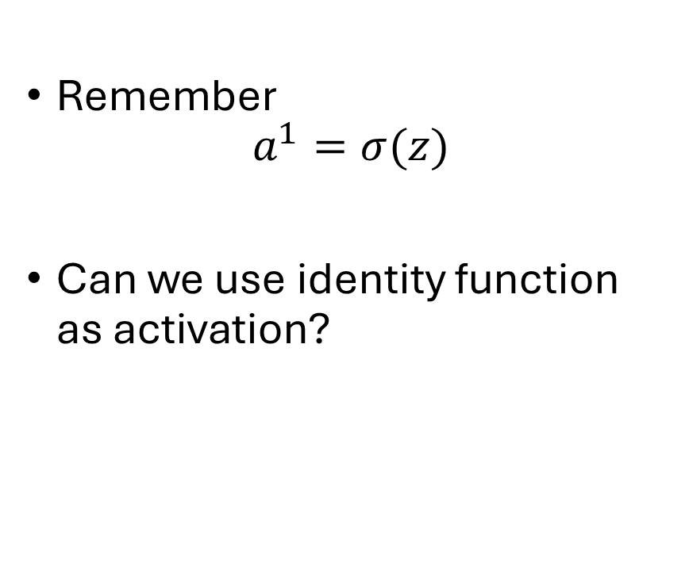
Why use non-linear activations?
Remember
$$a^{1}=σ(z)$$
Can we use identity function as activation?
In a two-layer neural network,

Slide 18

Fully-connected Neural Network
How to learn the parameters $W^{[i]}$ and $b^{[i]}$
$$z_{1}^{}$$
$$z_{2}^{}$$
$$w_{1}^{1}$$
$$w_{1}^{1}$$
$$w_{2}^{1}$$
$$w_{2}^{1}$$
$$x_{1}$$
$$w_{3}^{1}$$
$$w_{3}^{1}$$
$$w_{4}^{1}$$
$$w_{4}^{1}$$
$$x_{2}$$
Input
Layer
$$w_{m}^{1}$$
$$w_{n_{1}}^{1}$$
Output
Layer
Hidden Layers

Slide 19
Fully-connected Neural Network
How to do classification?
The output layer (discussed so far),
How to perform classification task?
Binary Classification
Multi-class Classification
$$z_{1}^{}$$
$$z_{2}^{}$$
$$w_{1}^{1}$$
$$w_{1}^{1}$$
$$w_{2}^{1}$$
$$w_{2}^{1}$$
$$x_{1}$$
$$w_{3}^{1}$$
$$w_{3}^{1}$$
$$w_{4}^{1}$$
$$w_{4}^{1}$$
$$x_{2}$$
Input
Layer
$$w_{m}^{1}$$
$$w_{n_{1}}^{1}$$
Output
Layer
Hidden Layers

Slide 20
Fully-connected Neural Network
Binary Classification
We can use a single output node
Apply sigmoid function on the last layer
We can also use two output nodes each returning the probability of being in the corresponding class
$$z_{1}^{}$$
$$z_{2}^{}$$
$$w_{1}^{1}$$
$$w_{1}^{1}$$
$$w_{2}^{1}$$
$$w_{2}^{1}$$
$$x_{1}$$
$$w_{3}^{1}$$
$$w_{3}^{1}$$
$$w_{4}^{1}$$
$$w_{4}^{1}$$
$$x_{2}$$
Input
Layer
$$w_{m}^{1}$$
$$w_{n_{1}}^{1}$$
Output
Layer
Hidden Layers

Slide 21
Fully-connected Neural Network
Multi-class Classification
What to do?
$$z_{1}^{}$$
$$z_{2}^{}$$
$$w_{1}^{1}$$
$$w_{1}^{1}$$
$$w_{2}^{1}$$
$$w_{2}^{1}$$
$$x_{1}$$
$$w_{3}^{1}$$
$$w_{3}^{1}$$
$$w_{4}^{1}$$
$$w_{4}^{1}$$
$$x_{2}$$
Input
Layer
$$w_{m}^{1}$$
$$w_{n_{1}}^{1}$$
Output
Layer
Hidden Layers

Slide 22


Multi-class Classification
Example,
Predict whether the image is of a cat, chicken or dog?
We can represent them as
where the integers represents
respectively.
$$z_{1}^{}$$
$$z_{2}^{}$$
$$w_{1}^{1}$$
$$w_{1}^{1}$$
$$w_{2}^{1}$$
$$w_{2}^{1}$$
$$x_{1}$$
$$w_{3}^{1}$$
$$w_{3}^{1}$$
$$w_{4}^{1}$$
$$w_{4}^{1}$$
$$x_{2}$$
Input
Layer
$$w_{m}^{1}$$
$$w_{n_{1}}^{1}$$
Output
Layer
Hidden Layers

Slide 23
Multi-class Classification
Example,
Predict whether the image is of a cat, chicken or dog?
Instead use one-hot encoding
Equivalent to three binary classifications
$$z_{1}^{}$$
$$z_{2}^{}$$
$$w_{1}^{1}$$
$$w_{1}^{1}$$
$$w_{2}^{1}$$
$$w_{2}^{1}$$
$$x_{1}$$
$$w_{3}^{1}$$
$$w_{3}^{1}$$
$$w_{4}^{1}$$
$$w_{4}^{1}$$
$$x_{2}$$
Input
Layer
$$w_{m}^{1}$$
$$w_{n_{1}}^{1}$$
Output
Layer
Hidden Layers

Slide 24
Fully-connected Neural Network
Multi-class Classification
Encode classes using one-hot encoding
Output layer units, m
One unit corresponding to each class
Sigmoid on each unit returning probabilities
The summation of output probabilities may be below or above 1
$$z_{1}^{}$$
$$z_{2}^{}$$
$$w_{1}^{1}$$
$$w_{1}^{1}$$
$$w_{2}^{1}$$
$$w_{2}^{1}$$
$$x_{1}$$
$$w_{3}^{1}$$
$$w_{3}^{1}$$
$$w_{4}^{1}$$
$$w_{4}^{1}$$
$$x_{2}$$
Input
Layer
$$w_{m}^{1}$$
$$w_{n_{1}}^{1}$$
Output
Layer
Hidden Layers

Slide 25
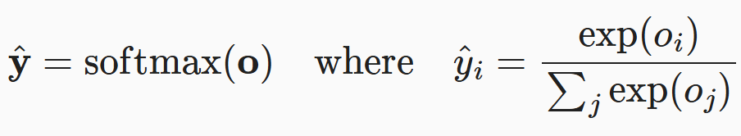
Fully-connected Neural Network
Multi-class Classification
Encode classes using one-hot encoding
Output layer units, m
One unit corresponding to each class
Perform softmax over the outputs/logits
$$z_{1}^{}$$
$$z_{2}^{}$$
$$w_{1}^{1}$$
$$w_{1}^{1}$$
$$w_{2}^{1}$$
$$w_{2}^{1}$$
$$x_{1}$$
$$w_{3}^{1}$$
$$w_{3}^{1}$$
$$w_{4}^{1}$$
$$w_{4}^{1}$$
$$x_{2}$$
Input
Layer
$$w_{m}^{1}$$
$$w_{n_{1}}^{1}$$
Output
Layer
Hidden Layers

Slide 26
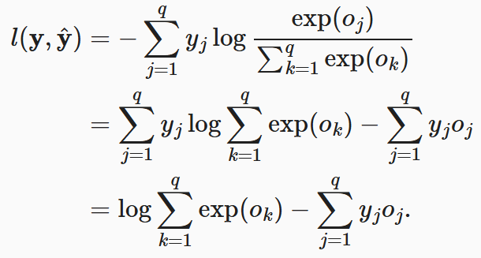

Fully-connected Neural Network
Multi-class Classification
Loss function where $y$ is the ground truth and $\hat{y}$ is the predicted label
$$z_{1}^{}$$
$$z_{2}^{}$$
$$w_{1}^{1}$$
$$w_{1}^{1}$$
$$w_{2}^{1}$$
$$w_{2}^{1}$$
$$x_{1}$$
$$w_{3}^{1}$$
$$w_{3}^{1}$$
$$w_{4}^{1}$$
$$w_{4}^{1}$$
$$x_{2}$$
Input
Layer
$$w_{m}^{1}$$
$$w_{n_{1}}^{1}$$
Output
Layer
Hidden Layers

Slide 27
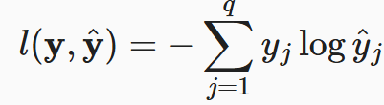
Fully-connected Neural Network
Multi-class Classification
Loss function where $y$ is the ground truth and $\hat{y}$ is the predicted label
$$z_{1}^{}$$
$$z_{2}^{}$$
$$w_{1}^{1}$$
$$w_{1}^{1}$$
$$w_{2}^{1}$$
$$w_{2}^{1}$$
$$x_{1}$$
$$w_{3}^{1}$$
$$w_{3}^{1}$$
$$w_{4}^{1}$$
$$w_{4}^{1}$$
$$x_{2}$$
Input
Layer
$$w_{m}^{1}$$
$$w_{n_{1}}^{1}$$
Output
Layer
Hidden Layers

Slide 28
Fully-connected Neural Network
Multi-class Classification
Loss function where $y$ is the ground truth and $\hat{y}$ is the predicted label
$$z_{1}^{}$$
$$z_{2}^{}$$
$$w_{1}^{1}$$
$$w_{1}^{1}$$
$$w_{2}^{1}$$
$$w_{2}^{1}$$
$$x_{1}$$
$$w_{3}^{1}$$
$$w_{3}^{1}$$
$$w_{4}^{1}$$
$$w_{4}^{1}$$
$$x_{2}$$
Input
Layer
$$w_{m}^{1}$$
$$w_{n_{1}}^{1}$$
Output
Layer
Hidden Layers

Slide 29
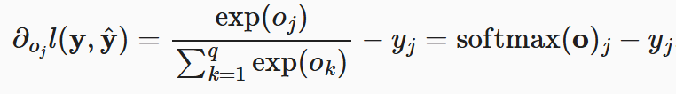

Fully-connected Neural Network
Multi-class Classification
Loss function where $y$ is the ground truth and $\hat{y}$ is the predicted label
Derivative of the loss function,
$$z_{1}^{}$$
$$z_{2}^{}$$
$$w_{1}^{1}$$
$$w_{1}^{1}$$
$$w_{2}^{1}$$
$$w_{2}^{1}$$
$$x_{1}$$
$$w_{3}^{1}$$
$$w_{3}^{1}$$
$$w_{4}^{1}$$
$$w_{4}^{1}$$
$$x_{2}$$
Input
Layer
$$w_{m}^{1}$$
$$w_{n_{1}}^{1}$$
Output
Layer
Hidden Layers

Slide 30
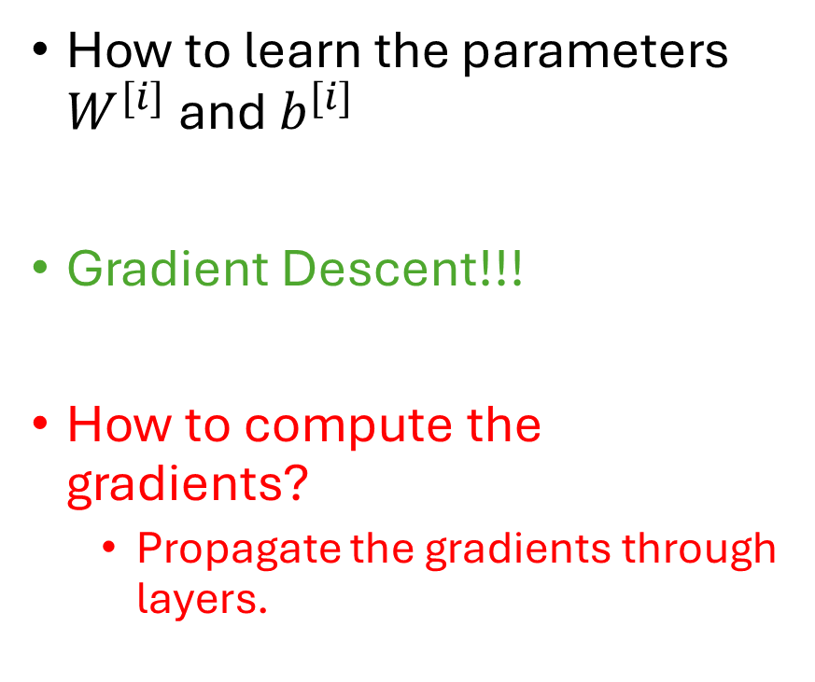
Fully-connected Neural Network
How to learn the parameters $W^{[i]}$ and $b^{[i]}$
Gradient Descent!!!
How to compute the gradients?
Propagate the gradients through layers.
$$z_{1}^{}$$
$$z_{2}^{}$$
$$w_{1}^{1}$$
$$w_{1}^{1}$$
$$w_{2}^{1}$$
$$w_{2}^{1}$$
$$x_{1}$$
$$w_{3}^{1}$$
$$w_{3}^{1}$$
$$w_{4}^{1}$$
$$w_{4}^{1}$$
$$x_{2}$$
Input
Layer
$$w_{m}^{1}$$
$$w_{n_{1}}^{1}$$
Output
Layer
Hidden Layers

Slide 31
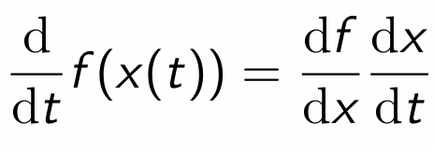

Backpropagation
Univariate Chain Rule
If $f(x)$ and $x(t)$ are univariate functions,

Slide 32
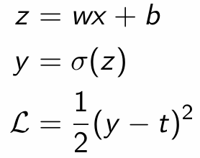
Backpropagation
For example, univariate logistic least square model.
Let’s compute the loss derivative.

Slide 33
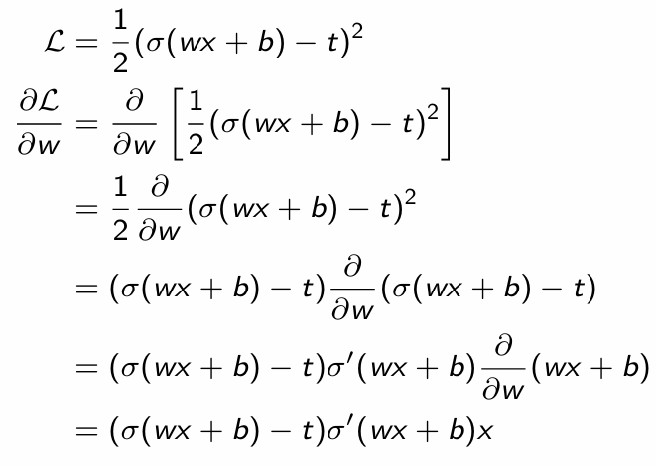
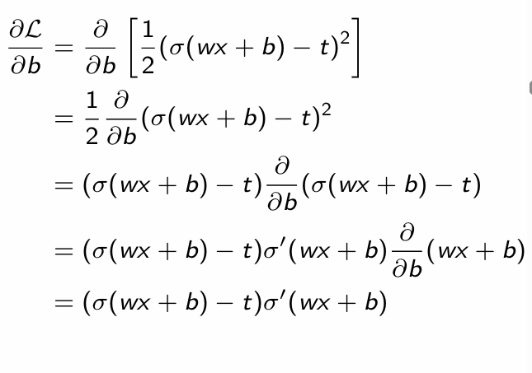
Backpropagation

Slide 34
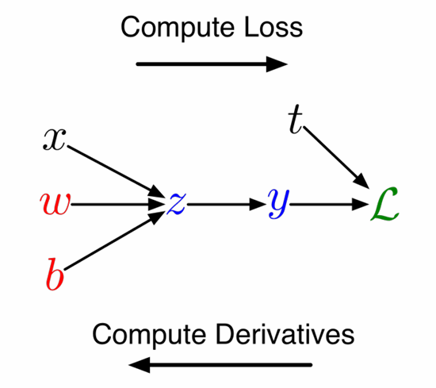
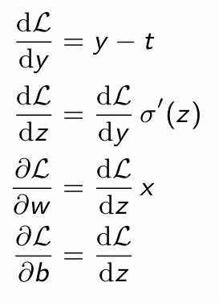
Backpropagation
A more structured way to do it,

Slide 35
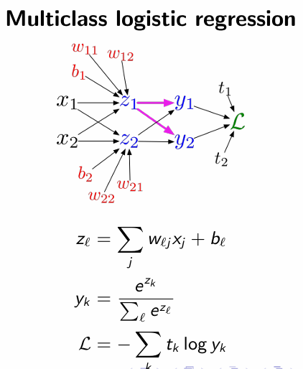
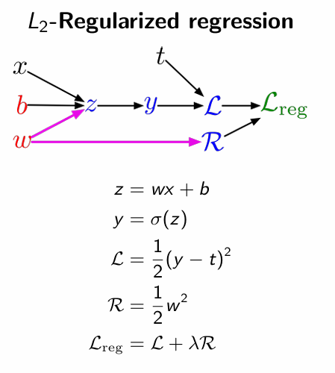
Backpropagation
What about multivariate chain rule?

Slide 36
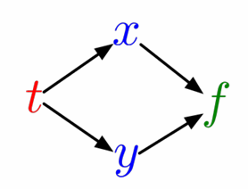
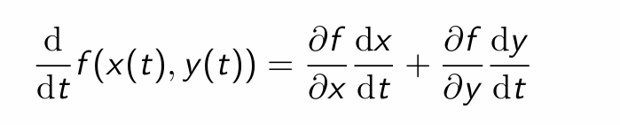
Backpropagation
Multivariate chain rule
If f(x, y) is a function of x(t) and y(t), then

Slide 37
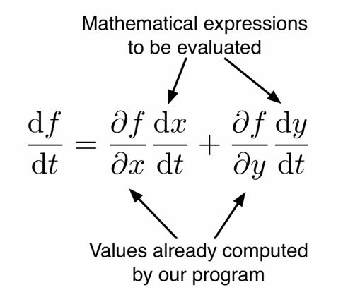
Backpropagation
Multivariate chain rule
If f(x, y) is a function of x(t) and y(t), then
In the context of backpropagation,

Slide 38
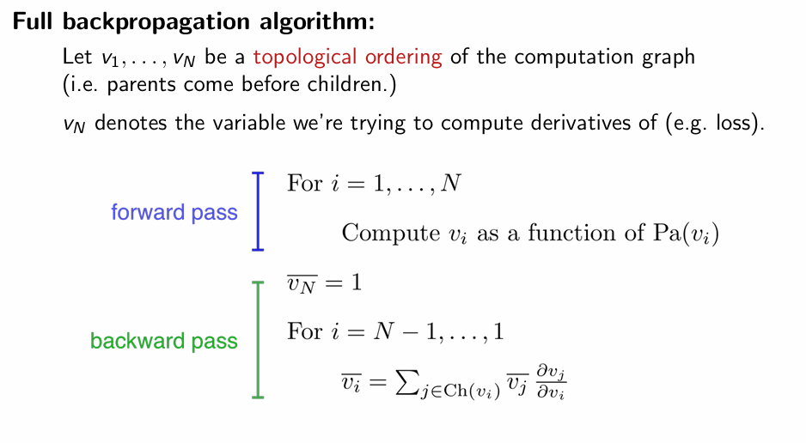
Backpropagation

Slide 39
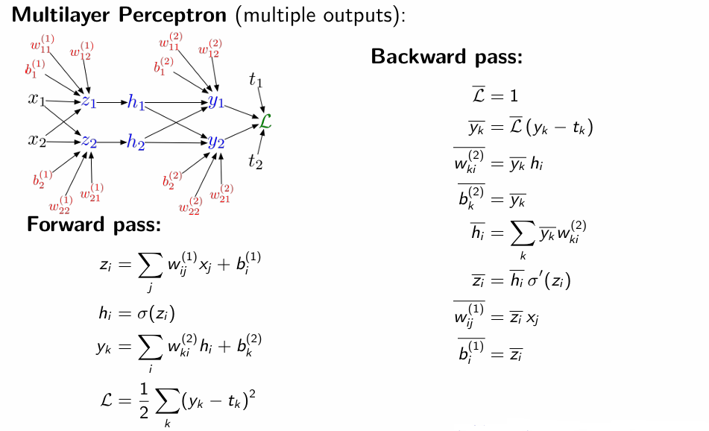
Backpropagation

Slide 40
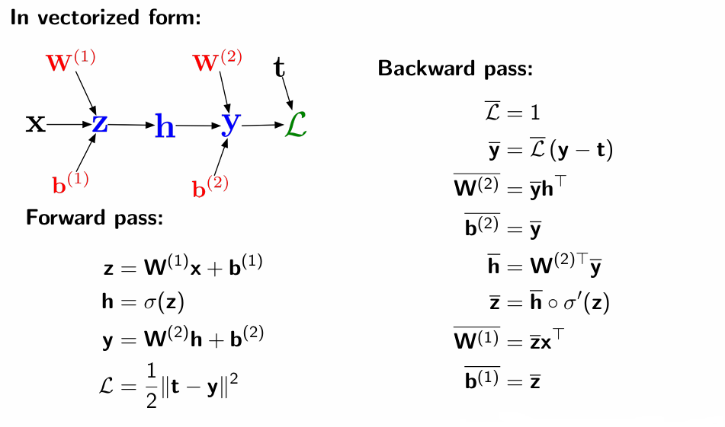
Backpropagation

Slide 41


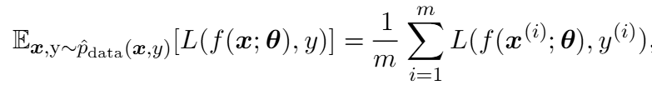



Optimization
Supervised Learning Task
Given the data-generating distribution is,
$$\left(x, y\right)∼p_{data}$$
Goal: Minimize the loss
In reality,
Given the training data,
$$\left(x, y\right)∼{\hat{p}}_{data}$$
Goal: Minimize empirical loss,
Optimization $≠$ Learning

Slide 42
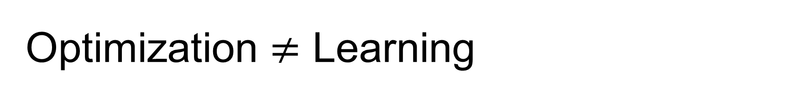
Optimization $≠$ Learning
Empirical Risk Minimization
Often cannot optimize the true loss
0-1 loss; No useful derivatives
Use of surrogate loss such as negative log likelihood
Early stopping
0-1 loss on validation set

Slide 43
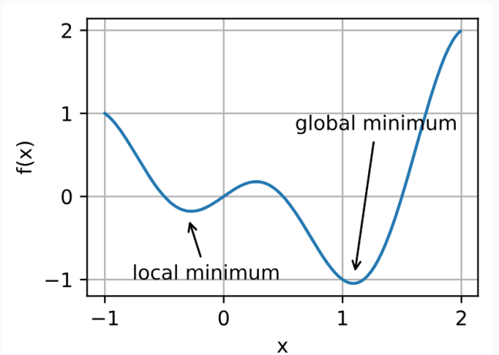
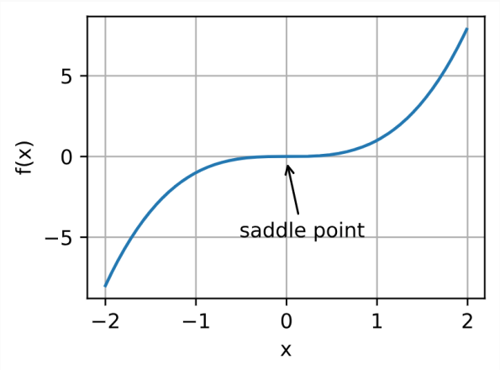

Optimization Challenges in Deep Learning
Local Minima
Saddle Points
Vanishing Gradients

Slide 44


Convexity
Given a convex set $X$, a function $f: X→ R$ is convex if for all $x, x^{′}∈X,$

Slide 45

Convexity
Given a convex set $X$, a function $f: X→ R$ is convex if for all $x, x^{′}∈X,$

Slide 46
Optimizers
Gradient Descent
Batch-gradient descent
Stochastic gradient descent
Mini-batch stochastic gradient descent
Why use mini-batch?
Gradient computation is very expensive
Redundancy in training set
Can also run in parallel

Slide 47
Mini-Batch Stochastic Gradient Descent
At each epoch,
Go over the entire training data once
Make a vector of training data indices (1,…,N)
Shuffle the vector,
epoch_idx=shuffle(1,…,N)
Divide epoch_idx into equal-size mini-batches.
Say, mini-batch has size k, then
The first mini-batch uses examples
D1={(xj,yj):j=epoch_idx[0:k]}
The second mini-batch uses examples D2={(xj,yj):j=epoch_idx[k:2k]}
And so on
Once all mini-batches are exhausted, we start a new epoch
If N is not a multiple of k, we ignore the last
mini-batch (whose size is smaller than k).

Slide 48




Mini-Batch Stochastic Gradient Descent
Mini-batches yields an unbiased estimate of batch gradient if sampled randomly
Mini-batch stochastic gradient
Here, $B$ indicates a mini-batch
True Empirical Loss
True gradient

Slide 49


Mini-Batch Stochastic Gradient Descent
Mini-batches yields an unbiased estimate of batch gradient if sampled randomly
Mini-batch stochastic gradient
Here, $B$ indicates a mini-batch
Un-biasedness
If batches are sampled uniformly at random,
By definition,

Slide 50


Mini-Batch Stochastic Gradient Descent
Mini-batches yields an unbiased estimate of batch gradient if sampled randomly
Mini-batch stochastic gradient
Here, $B$ indicates a mini-batch
Since the mini-batch is uniformly sampled,
But a smaller variance is estimated compared to SGD,

Slide 51
Mini-Batch Stochastic Gradient Descent
Mini-batches yields an unbiased estimate of batch gradient if sampled randomly
Mini-batch stochastic gradient
Here, $B$ indicates a mini-batch
Variance decreases as mini-batch size m increases.
With full batch (m=N), variance becomes zero.
Small m → more noise → unstable updates
This motivates learning rate schedules or batch size growth in training.

Slide 52

Optimizers
Gradient Descent
Batch-gradient descent
Stochastic gradient descent
Mini-batch stochastic gradient descent
$$θ←θ −ε∇g(θ)$$

Slide 53

Optimizers
Gradient Descent
Batch-gradient descent
Stochastic gradient descent
Mini-batch stochastic gradient descent
Stochastic gradient descent with momentum

Slide 54

Optimizers
Gradient Descent
Batch-gradient descent
Stochastic gradient descent
Mini-batch stochastic gradient descent
Stochastic gradient descent with momentum
Stochastic gradient descent with nesterov momentum

Slide 55
Optimizers
Gradient Descent
Batch-gradient descent
Stochastic gradient descent
Mini-batch stochastic gradient descent
Stochastic gradient descent with momentum
Stochastic gradient descent with nesterov momentum

Slide 56

Optimizers with Adaptive Learning Rate

Slide 57

Optimizers with Adaptive Learning Rate

Slide 58


Optimizers with Adaptive Learning Rate

Slide 59
Hyper Parameter
Number of epochs
Learning Rate
Weight Decay
Batch Size, etc.

Slide 60

MLP as a Function Approximator
Which functions $f:ℝ^{m}→ℝ^{m}$ can a multilayer feedforward networks arbitrarily approximate?
Assuming freedom to choose any model and its parameter
Can approximate any continuous function as long as,
The activation functions σ are not algebraic polynomials almost everywhere
Leshno, Moshe, Vladimir Ya Lin, Allan Pinkus, and Shimon Schocken. "Multilayer feedforward networks with a nonpolynomial activation
function can approximate any function." Neural networks 6, no. 6 (1993): 861-867.

Slide 61
Reference
D2l
Deep Learning

